Slide 1
free swimming

Slide 3

FM sound

Slide 4
gap

Slide 5
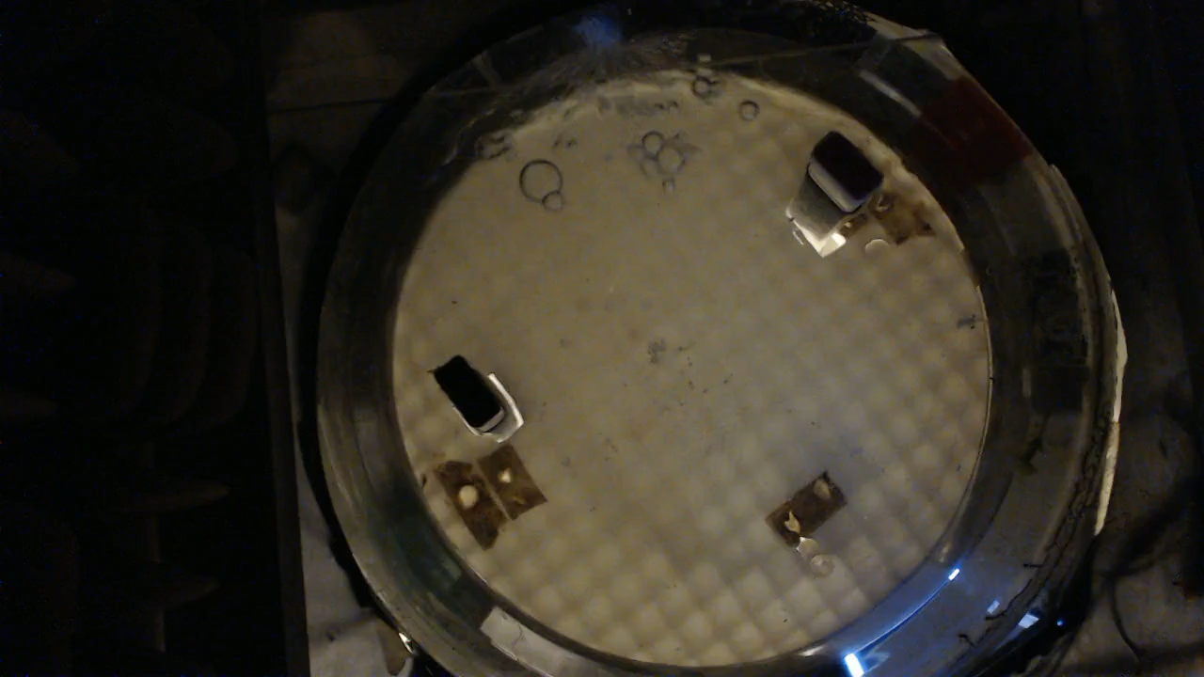
social reward

Slide 6
break

